Slide 1
Code Readability of a Java Source code
GCIS 698 Plan B – Technical Research
Amer Kaleemullah

Slide 2
Background
Code readability relates to how well a piece of code can be comprehended.
Careful selection of variable names, adequate usage of white space and tabs, etc. is vital to readability.
Marc Brysbaert, Amy Beth Warriner, and Victor Kuperman developed a metric for code readability.
  These linguists developed a dictionary to calculate concreteness.
  Concreteness measurements exists only for words/variables and not a class.

Slide 3
Background (cont.)
Some studies have indicated that the code readability is related to bugs.
There exists no method to determine the complexity of a Java software code based on the readability.
My project focuses on evaluating the code readability of software written in Java.
This project implements a complex 3 step approach of calculating the readability of a variety of programs.

Slide 4
Introduction
Element | Description
The Problem of … | How to measure the readability of a java class
Affects … | All programmers & QA testers
And Results in … | Reusability and difficulty in maintenance and deployment
Benefits of a solution … | Easy to understand the purpose of a code

Slide 5
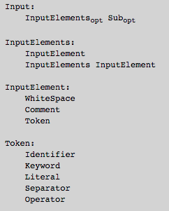

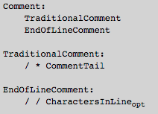
Java Lexical Grammar
Notes:
This grammar has as its terminal symbols the characters of the Unicode character set. It defines a set of productions, starting from the goal symbol Input, that describe how sequences of Unicode characters are translated into a sequence of input elements.
These input elements, with white space and comments discarded, form the terminal symbols for the syntactic grammar for the Java programming language and are called tokens. These tokens are the identifiers, keywords, literals, separators, and operators of the Java programming language.

Slide 6
Objective
Code a measuring system/algorithm in Java to evaluate the readability of an entire software code through its analysis reports.
Notes:
One algorithm or measure system, to evaluate the readability of a class, everything else is the approach
Approach:
1 Method body
multiple methods and how its works together
Example: max(string, int, etc.) integrate with body and name together
Build graph and coding relationship must be represented.
SUREVY: CODE TO STUDENTS AND ASK SUBJECTIVE OPINion OF a code and correlate it with the results of my project

Slide 7
Approach (3 Phases)
Ph 1. Measure the readability of one method body and then multiple methods (they could be related or not).
Ph 1.2. Determine the amount of Calls made and received by every method and figure out the direction.
Ph. 2. Using results obtained from the last phase, determine the readability of methods using data which says where a variable was declared and used.
Ph 3. Code an algorithm to measure the whole concreteness of an entire software code using method readability and methods calls in and out.

Slide 8
Types of Software Code
Dr. Xu has provided me with 12 software codes that covers a variety of Java programs which are quite large and time consuming to generate reports.
Before jumping to the highly complex codes, I first ran my analyses on a few simple codes for ease of understanding and generating the results.
These simple codes were written by me, and each program is structured around either a Class Chain-link, Satellite or Tree structure.

Slide 9
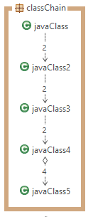
Types of Software Code
CLASS CHAIN
  Here, from the top level class onwards, every class creates an object from the proceeding class and calls 2 methods, namely:
      The Constructor method
      The Employee method: This simple method creates an employee object and assigns values.

Slide 10
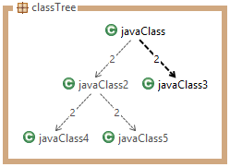
Types of Software Code
CLASS TREE
  Similarly, here from the top level class onwards, every class creates an object from the proceeding class and calls 2 methods, namely:
      The Constructor method
      The Employee method: This simple method creates an employee object and assigns values.

Slide 11
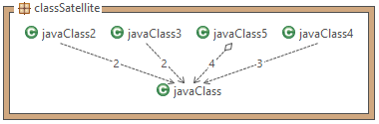
Types of Software Code
CLASS SATELLITE
  Here, javaClass creates an object from each of the proceeding classes and calls 2 methods, namely:
      The Constructor method
      The Employee method: This simple method creates an employee object and assigns values.

Slide 12
Technical Approach
Reports
Phase1
Phase 2
Phase 3

Slide 13
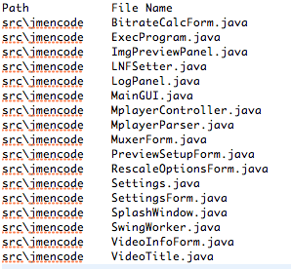
Report Gen. (Phase 1, Task 1)
Phase 1 was divided into 3 Tasks.
Task 1: A File tree was created using SimpleFileWalker to determine the packages and sub-folders and the .java files present in them.

Slide 14
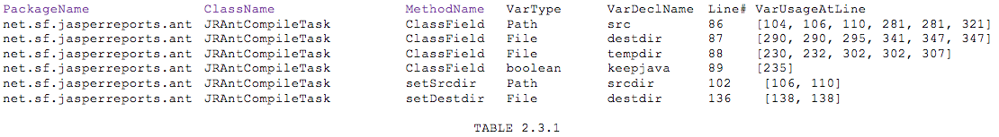
Report Gen. (Phase 1, Task 2)
Task 2: Here, the code refers to the file report generated from Task 1 to generate another report which lists the package, class, methods, variable type, variable, variable declaration and usage line numbers delimited by a tab. Antlr4 JavaBaseListener was customized to implement this.

Slide 15
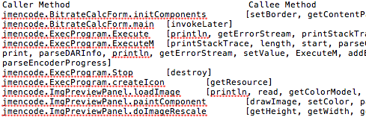
Report Gen. (Phase 1, Task 3)
Task 3: japa.parser.ast.body.ClassOrInterfaceDeclaration was used to log method instantiation and calls to generate a report with Caller Method and Calee Method.

Slide 16
Phase 2: Method Readability
Java code was customized to use the report from Task 2 to calculate the readability of each method based on line numbers of variable declaration and use.
In this, the readability of variables is determined by the Concreteness Ratings file by Brysbaert.
Then, the readability is divided by the average distance of variable declare and use.
Lastly, the readability of a method is evaluated as the average readability of the set of variables defined in that method.

Slide 17
Readability of Variables
The Brysbaert concreteness ratings excel file consists of 40,000 common words and their concreteness rating based on a 0-5 scale.
The readability of variables is determined by splitting variables into words based on hyphens, underscores and camel notations.
The split words’ ratings are determined and the average of them becomes the readability of the variable.

Slide 18
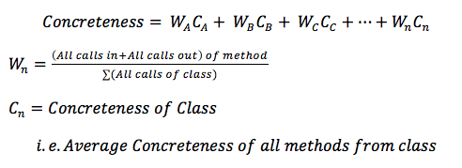
Phase 3:
Determining Concreteness
Algorithm for Concreteness of Software Code:

Slide 19

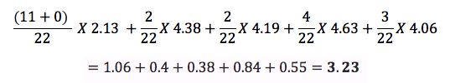
Demonstration of Algorithm

Slide 20
Results:
Project Name | Description | Readability | Lines of Code x 1000
Avuze | P2P File Share | 1.996 | 201.994
Xholon | Simulator | 1.831 | 21.288
soapUI | Web App | 2.293 | 30.367
datacrow | Data Manager | 1.897 | 19.548
Freecol | Game | 2.208 | 29.751
jasperreports | Dynamic Content | 2.596 | 33.403
Jmencode | Video Encoder | 0.799 | 1.658
Jedit | Text Editor | 1.923 | 35.602
Jsch | Security | 1.583 | 9.44
Junit | Software Testing | 2.056 | 0.996
ganttproject | Scheduling | 1.932 | 30.096

Slide 21
Technical Approach
Correlation
Survey data
Results
Success
Phase 3
Notes:
Survey data: code given to students and asked them about subjective opinion:

Slide 22
Measures of Success
Development of the algorithm/measurement to gather data from various open source code.
Demonstration of the correlation b/w objective data and subjective data.
The testing and calculation of the correlation is accurate.
Evaluation of the potential factors that affects this correlation.
Notes:
Develop algorithm/measurement and lots of data: where is the data coming from, couple slides explaining that.
Calculate the collected data from dr. xu (data set)
Provide the testing and calculate the correlation
Evaluate the potential factor that affects this correlation.
Demostrate the correlation b/w objective data and subjective data. High (but how high percentages, more than 50%)

Slide 23
Schedule
Task # | Task Description | Duration
1 | Develop a java function to calculate method readability. | 1 Week
2 | Develop a java function to calculate multiple method readability. | 2 Weeks
3 | Develop a java function to calculate class readability. | 2 Weeks
4 | Verification of tasks results and/or rectification. | 1 Week
5 | Generate survey for students. | 1 Week
6 | Deploy survey and await completion. | 2 Weeks
7 | Analyze survey results and prepare for correlation task. | 1 Week
8 | Evaluate the correlation between subjective and objective data. | 2 Weeks
9 | Verify testing and calculation of correlation is accurate. | 1 Week
10 | Evaluation of the potential factors that affect this correlation. | 1 Week

Slide 24
THANK YOU

Slide 25
ANTLR (Another Tool for Language Recognition)
It is a powerful parser generator that can do:
  Reading
  Processing
  Executing
  Translating Structured text/binary files
It’s widely used to build languages, tools, and frameworks.
From a grammar, ANTLR generates a parser that can build and walk parse trees.

